Slide 1
Outline
Enforcing modularity with domains
  Domains and Memory manager
  Controlled sharing using several domains
  kernel and user mode
Virtualizing memory
  Virtualizing addresses
  Translating addresses using a page map
  Virtual address spaces
  Hardware versus software and TLB
  segments
Suggested reading
  5.3, 5.4

Slide 2
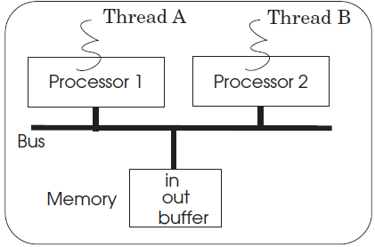
Enforcing modularity with domains
The implementation
of bounded buffers
  all threads share
  the same physical memory
Domains and a memory manager
  Enforce memory boundaries
  Assuming that the address space is very large

Slide 3
Enforcing modularity with domains
Domain （segment）
  a contiguous range of memory addresses
When invocating ALLOCATE_THREAD,
  a domain is specified in which the thread is to run.
The thread manager records a thread’s domain

Slide 4
Memory manager (MMU)
MMU （some hardware）
  Placed between a processor and the bus
  Includes a domain register
    contains two parts: low and high
      The lowest address the currently running thread is allowed to use
      The highest address
ALLOCATE_THREAD loads the processor’s domain register with the thread’s domain.

Slide 5
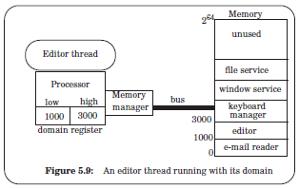
Memory manager

Slide 6
More features desired
A thread may need many domains,
  can control
    what memory they share
    what memory they keep private
A thread change its processor’s domain register ？ NO
  Otherwise the thread can make references to addresses that it shouldn’t

Slide 7
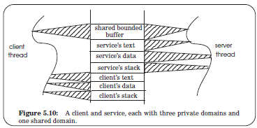

Controlled sharing using several domains
Allow each thread to have several domains
Each processor can have several domain registers as many as a thread needs
  for the moment

Slide 8
Implementing several domains
base_address ← ALLOCATE_DOMAIN (size)
  allocate a new domain of size bytes
  return the base address of the domain
a list of free memory regions
domain table
  each entry records the base_address and size

Slide 9
Implementing several domains
MAP_DOMAIN (base_address)
  Add the domain (starting at address base_address)
  to the calling thread’s domains
MAP_DOMAIN loads
  the domain’s bounds from the domain table
  into a domain register of the thread’s processor
If two or more threads map a domain, then that domain is shared

Slide 10
Access permissions
a domain register might include three bits
  READ, WRITE, or EXECUTE
  control access permission to any of the bytes in the associated domain
More controlled sharing:
  One thread can have access to a shared domain with only READ permission
  While another thread can have READ and WRITE permissions

Slide 11
Access permissions
MAP_DOMAIN (base_address, permission)
  loads the domain’s bounds from the domain table into one of the calling thread’s domain registers with permission permission

Slide 12
Access permissions
A LOAD instruction
  requires READ permission for its address
A STORE instruction
  requires WRITE permission for its address
Execute an instruction at the address in the PC
  requires EXECUTE permission
The domain holding instructions
  may also require READ permission
    because the program may have stored constants in the program text

Slide 13
Controlled sharing using several domains
1 procedure LOOKUP_AND_CHECK (integer address, perm_needed)
2 for each domain do // for each domain register of this processor
3 if CHECK_DOMAIN (address, perm_needed, domain) return domain
4 signal memory_fault
5
6 procedure CHECK_DOMAIN (integer address, perm_needed, domain) returns boolean
7 if domain.low ≤ address and address < domain.high then
8 if PERMITTED (perm_needed, domain.permission) then return TRUE
9 else signal permission_fault
10 return FALSE

Slide 14
Controlled sharing using several domains
11
12 procedure PERMITTED (perm_needed, perm_authorized) returns boolean
13 if perm_needed ⊂ perm_authorized then return TRUE // is perm_needed a subset?
else return FALSE // permission violation
illegal memory reference exception
  If address doesn’t fall in any domain
permission error exception
  If the address falls in a domain, but the threads didn’t have sufficient permissions

Slide 15
Access permissions
In practice, only a subset of the possible combinations of permissions are useful
  READ permission
  READ and WRITE permissions
  READ and EXECUTE permissions
  READ, WRITE, and EXECUTE permissions
    might be used self-modifying programs
      generates instructions
      then jumps to the generated instructions
EXECUTE permission or WRITE and EXECUTE permissions isn’t useful in practice

Slide 16
Access permissions
Supporting self-modifying programs
  is risky, e.g., using a buffer overrun attack
  have proven to be more trouble than they are worth
    except to system crackers
The same technique can also control access to devices
  If memory-mapped I/O is used,
  then domain registers can also control which devices a thread can use

Slide 17
Access permissions
The memory manager can implement security policies
  it controls which threads have access to which parts of memory
  It can deny or grant a thread’s request for allocating a new domain or for sharing an existing domain
  It can control which threads have access to which devices

Slide 18
Kernel and User Mode
How to control changes to the fields of a domain register
  low, high, and permission
kernel mode
  Add one bit to the processor to indicate the mode
  change the value of domain registers only in kernel mode
    generate an illegal instruction exception otherwise
  change the mode bit only in kernel mode

Slide 19
Kernel and User Mode
KERNEL-ONLY permission
  illegal to reference addresses in a domain with KERNEL-ONLY permission in user mode
    causes a permission error exception
Switch to kernel mode
  on an interrupt and
  on an exception
Then the handler can process
  the interrupt or exception
  invoke privileged instructions

Slide 20
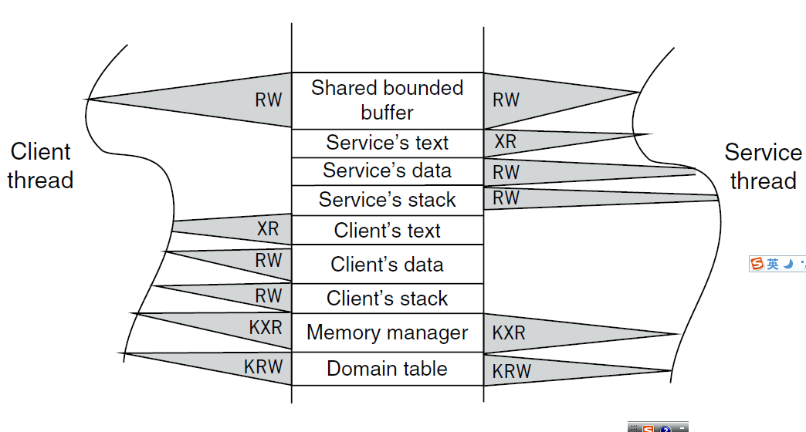

Kernel and User Mode

Slide 21
Gates and changing modes
Gates are addresses at which
  a thread may enter a kernel domain only
SVC (Supervisor call) instruction
  Specifies in a register for the intended gate
  Changes the processor mode from user to kernel
  Sets the PC to an address predefined by the hardware
    the entry point of the gate manager

Slide 22
Gates and changing modes
The gate manager
  Has control in kernel mode
  Call the appropriate procedures to serve the thread’s request
The gate manager has a table
  To record for each gate number the corresponding procedure
  the table might map gate 0 to ALLOCATE_DOMAIN
  map gate 1 to MAP_DOMAIN
  Map gate 2 to ALLOCATE_THREAD

Slide 23
Gates and changing modes
SVC steps must happen as a before-or-after action
  must be executed all without interruption,
  otherwise a thread
    might end up in kernel mode
    With its PC still pointing to an address in a user-level domain
    Can execute instructions from an application module in kernel mode

Slide 24
Gates and changing modes
return to user mode
  Change mode from kernel to user
  Load the program counter from the top of the stack into the PC
Don’t have to be a before-or-after action
The return sequence assumes
  the return address has been pushed on the stack before invoking SVC

Slide 25
Gates and changing modes
If a processor encounters an interrupt
  It enters a special gate for interrupts
  the gate manager dispatches the interrupt to the appropriate handler
    based on the source of the interrupt: clock interrupt, permission error, illegal memory reference, divide by zero
Some processors have a different gate for errors caused by exceptions
Others have only one gate for interrupts and exceptions

Slide 26
Enforcing modularity for bounded buffers
Put the buffer in a shared kernel domain, the threads
  cannot directly write the shared buffer in user mode
  must transition to kernel mode to copy messages into the shared buffer
SEND and RECEIVE are supervisor calls
  change to kernel mode
  copy the message from/to the thread’s domain to/from the shared buffer
  Programs running in kernel mode is written carefully
  Transitions between user mode and kernel mode can be expensive

Slide 27
Kernel Structure
kernel program
  a collection of modules running in kernel mode
  is usually called kernel for short
The kernel is a trusted intermediary
  the only program executing privileged instructions
    storing to a processor’s domain registers
  the application modules rely on the kernel to operate correctly

Slide 28
Monolithic Kernel
The kernel must be a trusted intermediary for the memory manager hardware,
  Many designers also make the kernel the trusted intermediary for all other shared devices
    the clock, display, disk
  Modules that manage these devices must be part of the kernel program
    the window manager, network manager , file manager
Monolithic kernel
  most of the operating system runs in kernel mode

Slide 29
Microkernel
small kernel -→ less # of bugs
Restrict errors in the module ( which generates the error)
  the file manager module error may overwrite kernel data structures unrelated to the file system
  causing unrelated parts of the kernel to fail
Notes:
We would like to keep the kernel small
Reduce the # of bugs
Restrict errors in the module which generates the error
the file manager module error may overwrite kernel data structures unrelated to the file system
causing unrelated parts of the kernel to fail

Slide 30
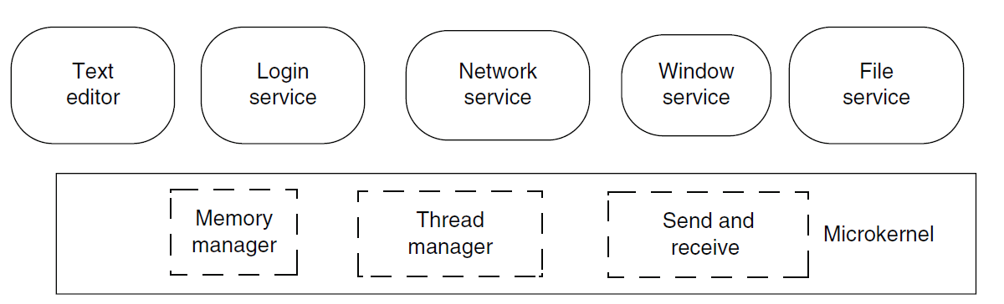
Microkernel
System modules run in user mode in their own domain
Microkernel itself implements a minimal set of abstractions
  Domains to contain modules
  threads to run programs
  virtual communication links

Slide 31
Microkernel vs. Monolithic Kernel
Few microkernel Os
Most widely-used operating systems have a mostly monolithic kernel.
  the GNU/Linux operating system
  the file and the network service run in kernel mode
  the X Window System runs in user mode.

Slide 32
Microkernel vs. Monolithic Kernel
A critical service doesn’t matter much if it fails
  Either in user mode or in kernel mode
  The system is unusable.
Some services are shared among many modules
  easier to implement these services as part of the kernel program, which is already shared among all modules
The performance of some services is critical
  the overhead of SEND and RECEIVE supervisor calls may be too large

Slide 33
Microkernel vs. Monolithic Kernel
Monolithic systems can enjoy the ease of debugging
It may be difficult to reorganize existing kernel programs
  There is little incentive to change a kernel program that already works
  If the system works and most of the errors have been eradicated
    the debugging advantage of microkernel begins to evaporate
    the cost of SEND and RECEIVE supervisor calls begins to dominate.

Slide 34
Microkernel vs. Monolithic Kernel
How to choose
  a working system and a better designed,
  but new system don’t switch over to the new system unless it is much better
The overhead of switching
  learning the new design
  re-engineering the old system to use the new design
  rediscovering undocumented assumptions
  discovering unrealized assumptions

Slide 35
Microkernel vs. Monolithic Kernel
the uncertainty of the gain of switching
  The claims about the better design are speculative
  There is little experimental evidence that
    microkernel-based systems are more robust than existing monolithic kernels

Slide 36
Virtualizing memory
The assumption:
  memory and its address space
    is very large, large enough to hold all domains
Memory and address space are limited
  ALLOCATE_DOMAIN is invoked
    a reasonable size must be specified
To allow a program to grow its domain
  an additional primitive GROW_DOMAIN

Slide 37
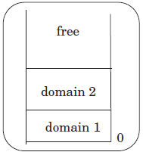
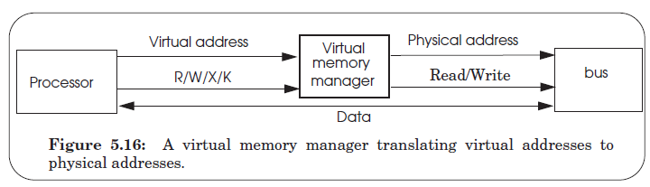
Virtualizing memory
Virtual addresses
Virtual address spaces
Virtual memory manager

Slide 38
Virtual Address
decouple modules with indirection
From a naming point of view
  the virtual memory manager creates a name space of virtual addresses on top of a name space of physical addresses
The virtual memory manager’s naming scheme
  translates virtual addresses into physical addresses
Managing physical memory transparently
Virtual memory transparently simulate a larger memory than the computer actually possesses

Slide 39
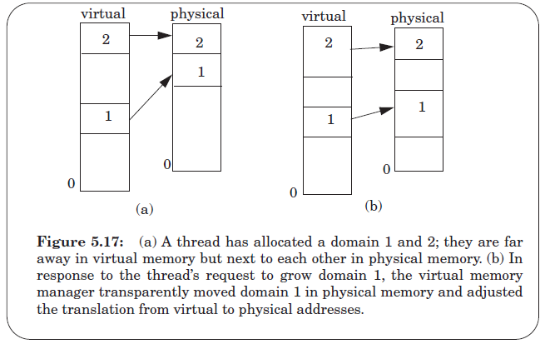
Virtual Address

Slide 40
Virtual Address
The cost of copying the content of a domain,
Complexity and performance
  must manage both virtual addresses and a physical address space
    must allocate and deallocate them (if the virtual address space isn’t large),
    must set up translations between virtual and physical addresses
  The translation happens on-the-fly
    may slow down memory references.

Slide 41
Translating addresses using a page map
Maintain a map
  records for each virtual address its corresponding physical address
The page map
  an array of page map entries
Page
  A fixed-sized range of contiguous bytes of virtual addresses
Block
  A fixed-sized range of contiguous bytes of physical addresses
Each entry translates a page to a block

Slide 42
Translating addresses using a page map
For now, the memory manager maintains a single page map so that all threads share the single virtual address space, as before

Slide 43
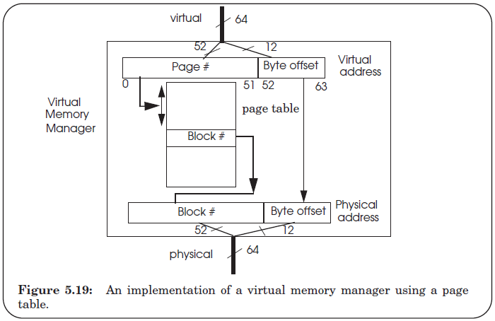
Translating addresses using a page map

Slide 44
Translating addresses using a page map
page table
  an array implementation
  the simplest implementation of a page map
  suitable when every page has a different block associated with
  stored in the same physical memory that holds the pages
page map address register
  Stores the physical address of the base of the page map（table）

Slide 45
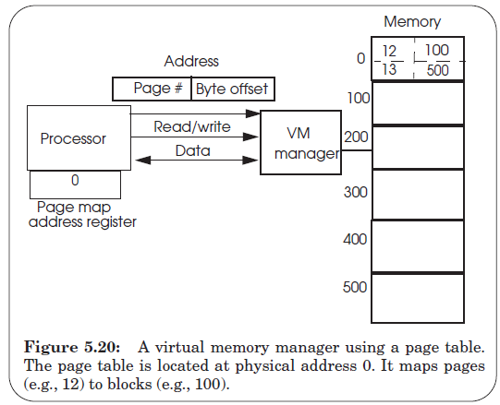
Translating addresses using a page map

Slide 46
Virtual address spaces
provides each application with the illusion
  it has a complete address space to itself
The virtual memory manager
  gives each virtual address space its own page map
id ←CREATE_ADDRESS_SPACE ()
block ← ALLOCATE_BLOCK ()
MAP (id, block, page_number, permission)
UNMAP (id, page_number)
FREE_BLOCK (block)
DELETE_ADDRESS_SPACE (id)

Slide 47
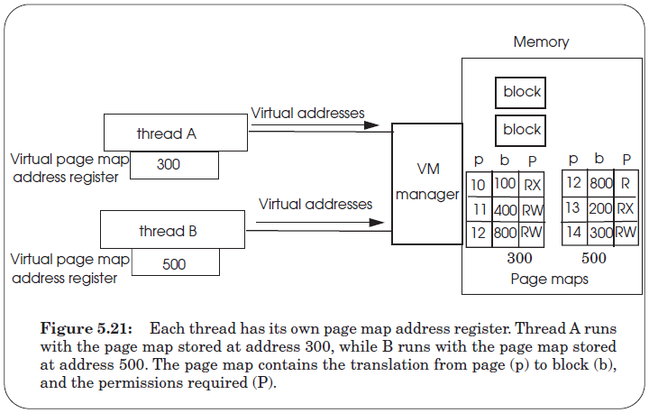
Virtual address spaces

Slide 48
Virtual address spaces
1 procedure TRANSLATE (integer virtual, perm_needed) returns physical
2 page ← virtual[0:41] // Extract page number (bits go left to right)
3 offset ← virtual[42:63] // Extract offset
4 page_table ← PMAR // Use the current page table
5 perm_page ← page_table[page].permissions // Lookup permissions for page
6 if PERMITTED (perm_needed, perm_page) then
7 block ← page_table[page].address // Index into page map
8 physical ← block + offset // Concatenate block and offset
9 return physical // return physical address
10 else return error

Slide 49
Kernel and Address Spaces
Each address space include a mapping of the kernel into its address space
  Only the user-mode bit must be changed when mode switches
  The kernel sets the permissions for kernel pages to KERNEL-ONLY
The kernel has its own separate address space
  inaccessible to user-level threads
  extend the SVC instruction to switch the page map address register

Slide 50
Other Issues
Position independent code vs. Sharing
Hardware vs. Software
TLB
Does hardware determine the format of the page table?

Slide 51
Segments
Provide each object with a virtual address space
  starting at 0 and ending at the size of the object
This allows threads to share memory at the granularity of objects

Slide 52
Segments
Each segment has its own domain register and a page_table in the domain register
  segment descriptors
Segment descriptor table
  putting the segment descriptors in a shared memory
Each processor has a single register
  points to the segment descriptor table

